Slide 1
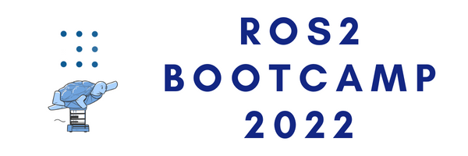


ROS2 BOOTCAMP DAY 4

Slide 2
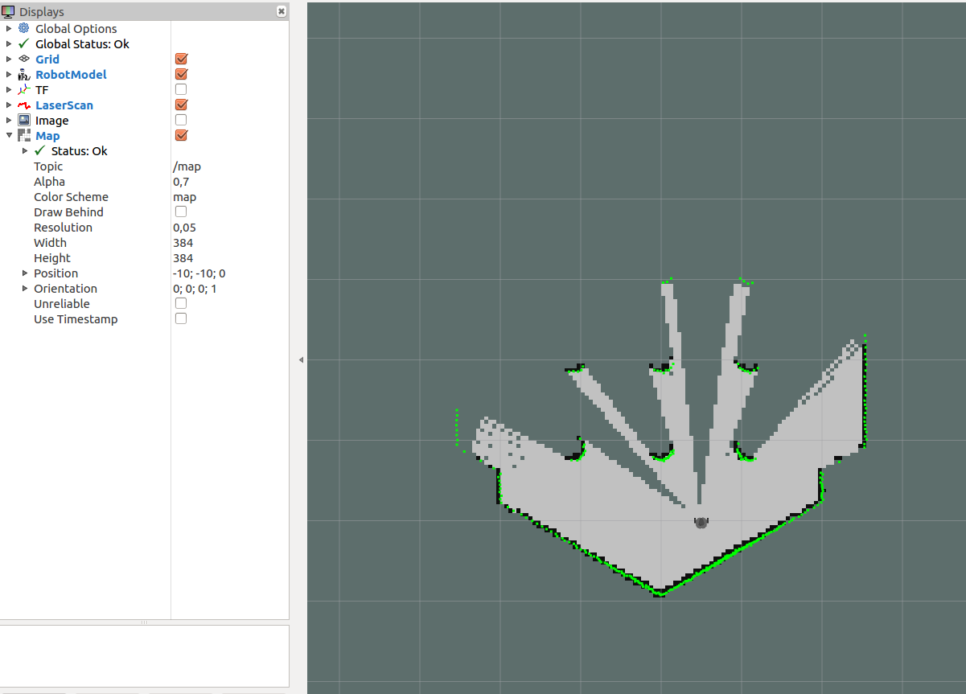
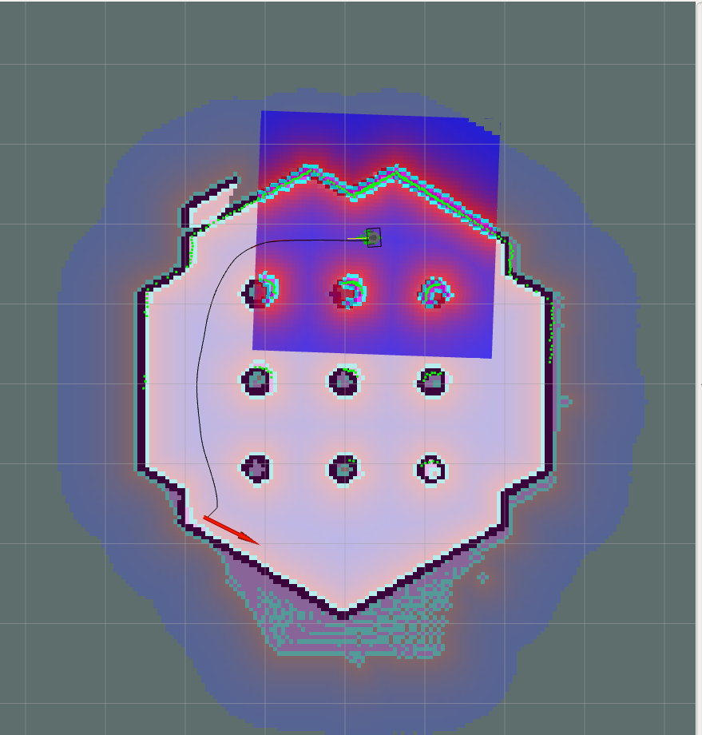
Topic for the Day
Knowledge Tree
Creating a Virtual Map from Sensor
Autonomous Navigation (using existing package)
Self-implement Autonomous Navigation (Competition!)
ROS Applications
Create the Map
Autonomous Navigation

Slide 3
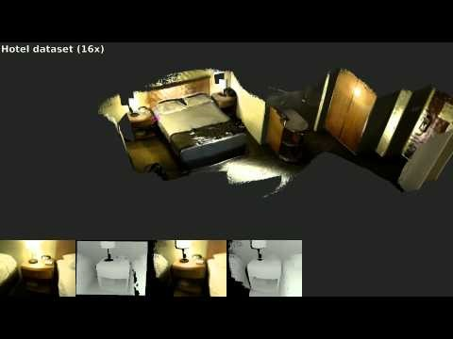
How is Navigation done?
Generating an awareness of unknown terrain through teleoperations. (Map)
Simultaneous reference from sensor data and map to host.
Also known as Simultaneous Localization and Mapping. (SLAM)
Notes:
How is navigation done? Done using sensor reading while simultaneously relating the data to the host of the sensor.

Slide 4
Knowledge Tree
Move Straight
Motion Control
Turn right/left
Wheel encoder
Inertial Measurement Unit
Odometry Estimation
Optical Flow
Visual Odometry (i.e. MonoSLAM, ORB-SLAM, etc)
Navigation
Lidar Odometry (i.e. LOAM, etc)
EKF SLAM
Mapping
Graph SLM
Particle Filter
Localization
Scan Match
Global Path Plan (i.e. A*, RRT, etc)
Path Plan
Local Path Plan (i.e. DWA, etc)
* The ROS navigation stack is a software architecture, which organizes these navigation elements.

Slide 5



Motion Control
Encoder
Encoder
Encoder
Encoder
Same Speed
Same Speed
Slow
Fast
Motor
Motor
Motor
Motor
Low Level
Computing Unit
Low Level
Computing Unit
Motor
Motor
Motor
Motor
Encoder
Encoder
Encoder
Encoder
Move Straight
Turn left

Slide 6
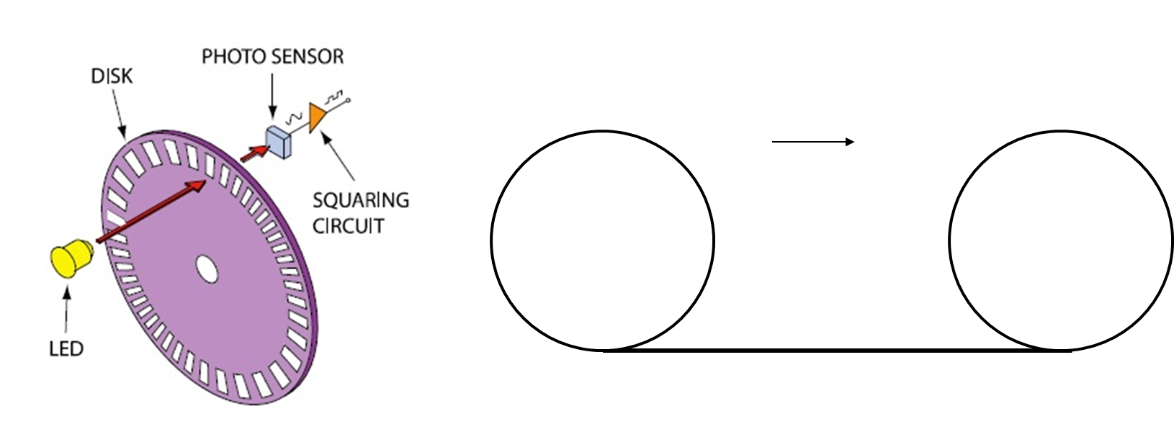
Motion Control
Each wheel encoder is used to count the number of times the motor (left or right) has rotated
In ideal case, the circumference of wheel is equal to the distance of movement
* https://www.quora.com/What-is-the-difference-between-SLAM-and-visual-odometry

Slide 7



Odometry Estimation
It estimates the change in position, step after step.
or
Lidar
360 Depth Camera
High Level
Computing Unit
(Navigation2 Stack)
Lidar Measurement

Slide 8
Odometry Estimation
1m, +- 0.1m
P₁
P₀

Slide 9
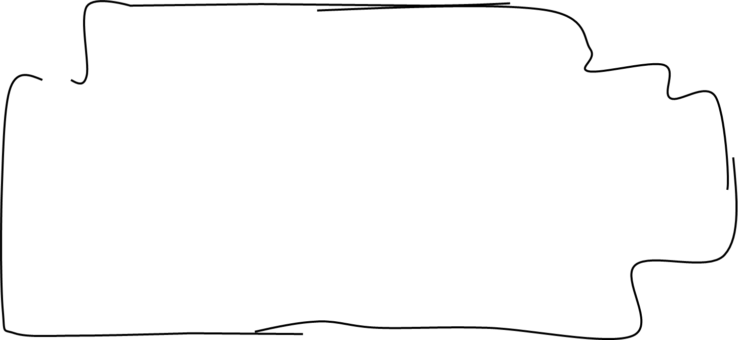
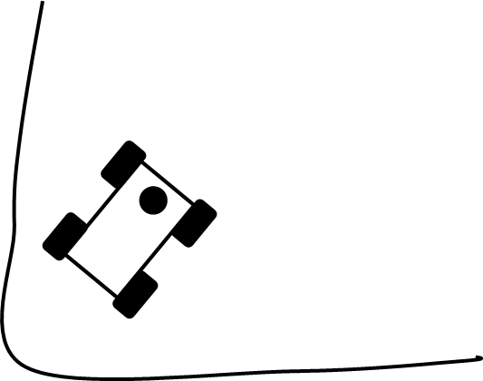
Localization
Localization is a method of finding the robot’s position relative to a map
Current Scan
Stored Map

Slide 10
Global Path Plan
The global path planning method can generate the path under a completely known map
Shortest Path
Target

Slide 11
Global Path Plan
Global Path Plan consists of Waypoints
  Waypoints are stopping place on a global path
Waypoint
Target

Slide 12
Local Path Plan
Path is generated by taking data from the sensors during movement of the robot
  Can generate new path depending on a new environment
Target

Slide 13
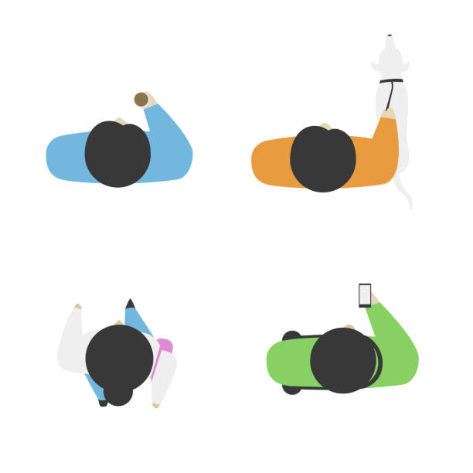
Local Path Plan
?
Target

Slide 14
Local Path Plan
Target

Slide 15
Global SLAM
It refines all poses from odometry estimation
1.1 m, +- 0.3m
1m, +- 0.1m
P₂
P₁
0.9 m, +- 0.1m
2 m, +- 0.5m
P₀
P₀
P₄
0.2 m, +- 0.3m
P₃

Slide 16
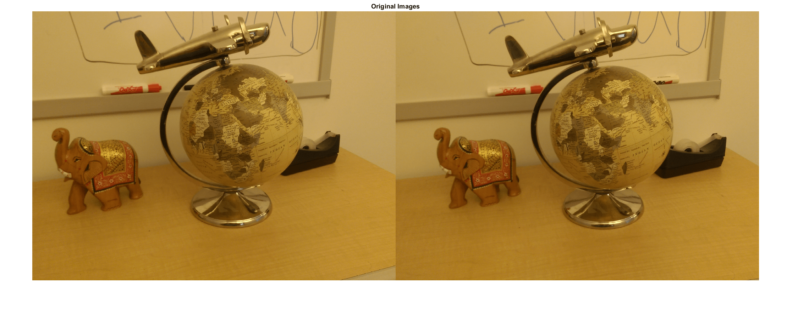
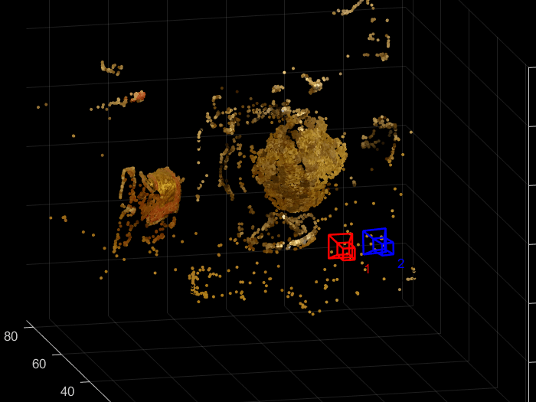
Visual Odometry
VO only aims to the local consistency of the trajectory
Visual Odometry Algorithm

Slide 17
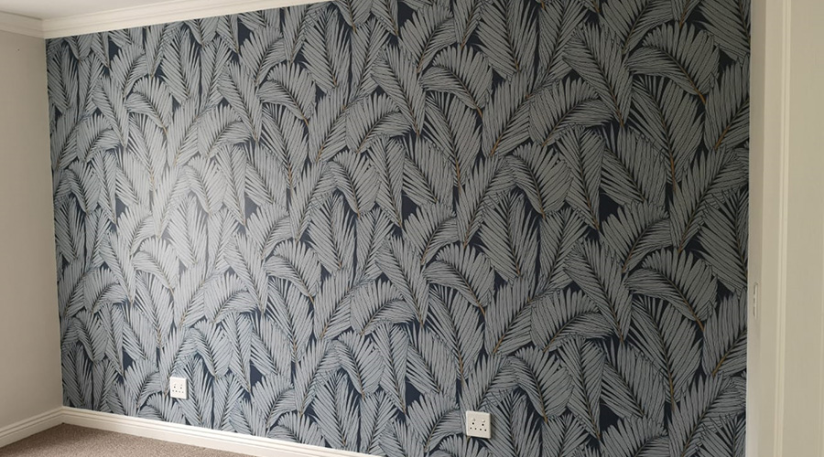
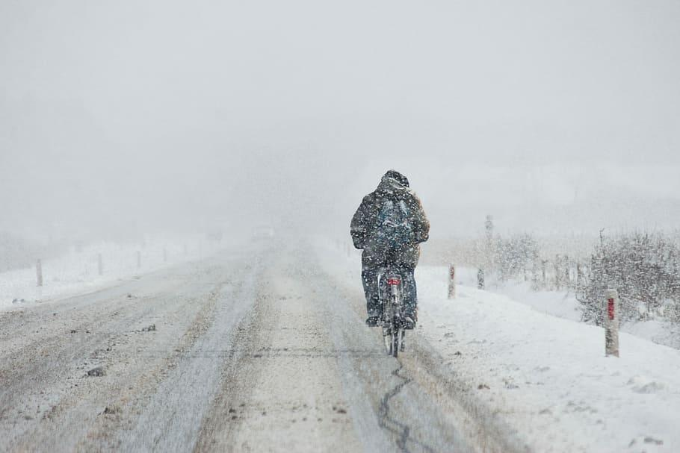
Odometry Noise
Repetitive Pattern
Featureless Scene

Slide 18
Odometry Noises
Other sources of Odometry Noises:
Mechanical structure (i.e. the limitations of physics)
Signal processing (i.e. analogue signal to digital signal conversation)
Inaccurate mathematical models
Environmental uncertainty (i.e. slips, etc.)
These errors will be accumulated over time.

Slide 19
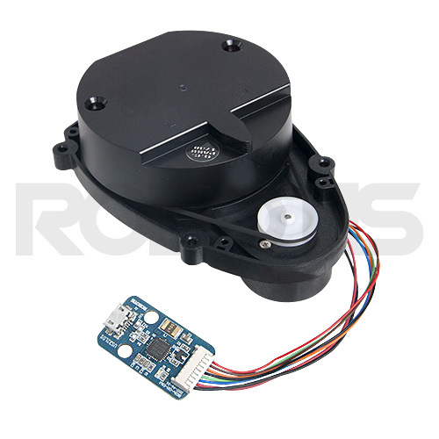
Creating a Virtual Map from Sensor
Turtlebot uses Laser Distance Sensor.
Constantly rotate to capture reading of “obstacles”
Existing ROS/Turtlebot SLAM packages:
  Gmapping
  Cartographer
  Hector Mapping
  Karto
  Frontier Exploration
You can test all different mapping algorithms!
Laser Distance Sensor (LIDAR)
source: http://www.robotis.us/360-laser-distance-sensor-lds-01-lidar/
Notes:
Done using sensor reading while simultaneously relating the data to the host of the sensor.
The costmap is the data structure that
represents places that are safe for the robot to
be in a grid of cells
•
•
The global navigation is used to create paths for
a goal in the map or a far-off distance
–
The
global costmap
is used for the global navigation
•
The local navigation is used to create paths in the
nearby distances and avoid obstacles
–
The
local costmap
is used for the local navigation
INFLATED_OBSTACLE
(253) -
Indicates no obstacle, but moving the center of the robot to
this location will result in a collision.

Slide 20
Exercise: Creating a virtual map in Gazebo (4.1)
Launch the turtlebot3 in simulation
Launch the cartographer node
Launch the teleop node to move the turtlebot around
Save the map
Edit the map(and add in a fake obstacle or something. Or you can clean away a real obstacle)
source: http://www.robotis.us/360-laser-distance-sensor-lds-01-lidar/
Notes:
Done using sensor reading while simultaneously relating the data to the host of the sensor.
The costmap is the data structure that
represents places that are safe for the robot to
be in a grid of cells
•
•
The global navigation is used to create paths for
a goal in the map or a far-off distance
–
The
global costmap
is used for the global navigation
•
The local navigation is used to create paths in the
nearby distances and avoid obstacles
–
The
local costmap
is used for the local navigation
INFLATED_OBSTACLE
(253) -
Indicates no obstacle, but moving the center of the robot to
this location will result in a collision.

Slide 21
Exercise: Using a virtual map in Gazebo (4.2)
Launch the turtlebot3 in simulation
Figure out where the map is being called in the launch file, and replace the launch parameter accordingly to where the map that you created in 3.1 is.
Launch the navigation node.
Localize the robot using the 2D Pose Estimate button.
Send Navigation goals to the robot.
source: http://www.robotis.us/360-laser-distance-sensor-lds-01-lidar/
Notes:
Done using sensor reading while simultaneously relating the data to the host of the sensor.
The costmap is the data structure that
represents places that are safe for the robot to
be in a grid of cells
•
•
The global navigation is used to create paths for
a goal in the map or a far-off distance
–
The
global costmap
is used for the global navigation
•
The local navigation is used to create paths in the
nearby distances and avoid obstacles
–
The
local costmap
is used for the local navigation
INFLATED_OBSTACLE
(253) -
Indicates no obstacle, but moving the center of the robot to
this location will result in a collision.

Slide 22
Competition: Maze Solver!
The idea of the maze solver was to detect the furthest distance in 3 directions: front, left and right. Next, the Turtlebot would go forward autonomously in the direction which has the furthest distance.
The first function (callback) subscribes to the /scan topic and gives the range between in the 3 directions. It also provides the index (maxpos) of which direction has the furthest distance.
The second function (location) subscribes to the /odom topic and gives the orientation of the Turtlebot in the unit of degrees (°).
The main function was split into 3 portions each doing its required navigation for the 3 directions. The left and right algorithm will be similar with the only difference in positive and negative velocity.
source: http://www.robotis.us/360-laser-distance-sensor-lds-01-lidar/
Notes:
Done using sensor reading while simultaneously relating the data to the host of the sensor.
The costmap is the data structure that
represents places that are safe for the robot to
be in a grid of cells
•
•
The global navigation is used to create paths for
a goal in the map or a far-off distance
–
The
global costmap
is used for the global navigation
•
The local navigation is used to create paths in the
nearby distances and avoid obstacles
–
The
local costmap
is used for the local navigation
INFLATED_OBSTACLE
(253) -
Indicates no obstacle, but moving the center of the robot to
this location will result in a collision.

Slide 23
LiDAR Range
Msgs.range[180]
Msgs.range[90]
Msgs.range[270]
Laser Distance Sensor (LIDAR)
Msgs.range[0]
source: http://www.robotis.us/360-laser-distance-sensor-lds-01-lidar/
Notes:
Done using sensor reading while simultaneously relating the data to the host of the sensor.
The costmap is the data structure that
represents places that are safe for the robot to
be in a grid of cells
•
•
The global navigation is used to create paths for
a goal in the map or a far-off distance
–
The
global costmap
is used for the global navigation
•
The local navigation is used to create paths in the
nearby distances and avoid obstacles
–
The
local costmap
is used for the local navigation
INFLATED_OBSTACLE
(253) -
Indicates no obstacle, but moving the center of the robot to
this location will result in a collision.

Slide 24
Install Dependencies!
. Install dependencies with rosdep
Sudo pip3 install transforms3d
source: http://www.robotis.us/360-laser-distance-sensor-lds-01-lidar/
Notes:
Done using sensor reading while simultaneously relating the data to the host of the sensor.
The costmap is the data structure that
represents places that are safe for the robot to
be in a grid of cells
•
•
The global navigation is used to create paths for
a goal in the map or a far-off distance
–
The
global costmap
is used for the global navigation
•
The local navigation is used to create paths in the
nearby distances and avoid obstacles
–
The
local costmap
is used for the local navigation
INFLATED_OBSTACLE
(253) -
Indicates no obstacle, but moving the center of the robot to
this location will result in a collision.

Slide 25
End of D4

Slide 26
Creating a Virtual Map from Sensor
Mapping obtain information from two types of sources:
  Idiotethic: using motion tracking (dead-reckoning)
  Allothetic: using sensor. (relativity)
The created map can come in the form of metric or topological.
Coordinate Map
Relation Map
Wall ahead from x = 0.5 to x = 1.0
At x = 0.1, a wall is 0.2 units away
Notes:
Motion tracking, it uses its known motion distance and the memory of the path to build a map. As send , it uses the absolute position which will induce cumulative error.
Allothetic uses sensor to

Slide 27
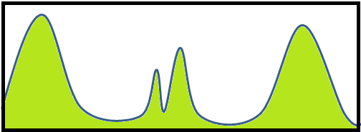
Creating a Virtual Map from Sensor
Localization is a method of finding position relative to a map.
3 Main Methods:
  Filter-based
. .
Step 1: Assumption Signals
Random Signal
Step 2: Single out Similar Readings
|||||||||||||||||||||||||||||||
Sensor Reading
Sensor Reading
Actual Location
Actual Location
Notes:
Let’s look at this example. Think that we are looking from top to bottom. ( the green peaks are the “walls”) and we only have map for this green peaks.
Firstly, we assign arbitrary signals to the map.
Second step, we single out readings which is similar to the current location.
At Step 2, I know I can be either at peak 1 or 2

Slide 28
Creating a Virtual Map from Sensor
Localization is a method of finding position relative to a map.
3 Main Methods:
  Filter-based
.
.
Step 3: Resample
Step 4: Move at Know speed
|
|
||||||||||||||||||||||||||||||||
|
|
||||||||||||||||||||||||||||||||||||||||
|
|
|
|
Sensor Reading
Sensor Reading
Actual Location
Actual Location
Notes:
Next, we resample the signals and assigning weight to the areas which has the similar reading.
Now, we move our robot towards the left, and repeating step 1 to 3.
At this plateau, we know it is the first plateau because if it is the second pleateau, the peak won’t match the match lower peak. And that the previous peak also doesn’t match the two highest peak.
After shifting (all previous signal in a bundle), I test the weight method (step 2) again and realized only one plausible plateau was found. Thus, we have successfully locailized

Slide 29
Creating a Virtual Map from Sensor
Localization is a method of finding position relative to a map.
3 Main Methods:
  Filter-based
|
|
|
|
|
||||||||||||||||||||||||||||||||
Signal Shifts back to its correct position
Sensor Reading
Actual Location
Notes:
Motion tracking, it uses its known motion distance and the memory of the path to build a map. As send , it uses the absolute position which will induce cumulative error.
Allothetic uses sensor to

Slide 30
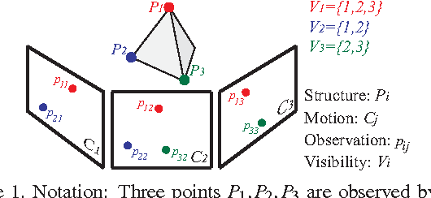
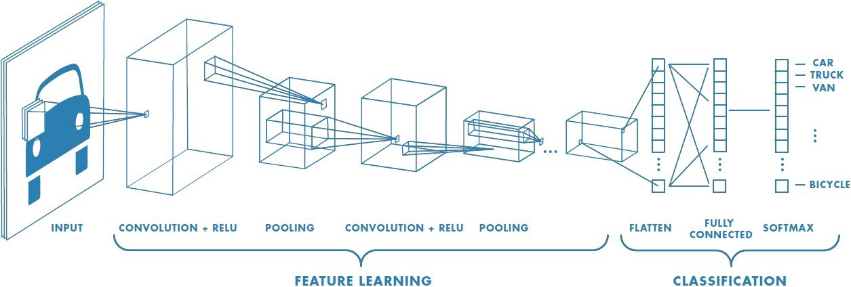
Creating a Virtual Map from Sensor
Localization is a method of finding position relative to a map.
3 Main Methods:
  Filter-based
  Global Optimization
  Convolutional neural network (deep learning)
Source: Furukawa, Yasutaka and Jean Ponce. “Accurate Camera Calibration from Multi-View Stereo and Bundle Adjustment.” 2008 IEEE Conference on Computer Vision and Pattern Recognition (2008): 1-8.
Source: https://towardsdatascience.com/a-comprehensive-guide-to-convolutional-neural-networks-the-eli5-way-3bd2b1164a53
Notes:
Global optimization it saves multiple key frame in the environment as example here, it has the three corner of the triangle we have. As we move, we try to match the points from each frame. (see the c1 , c2 ,c3 frames) we adjust the points on the frames until the ray p21 and p22 matches at the same p2 point, this must also satisfy other point as well. – this method of matching is also known as the bundle adjustment.
CNN we have a one in ROS call the RATSLAM – it recognizes feature based on the pixels intensity at each frame. So e.g. there more light at this region, turn at this region etc.

